Slide 1
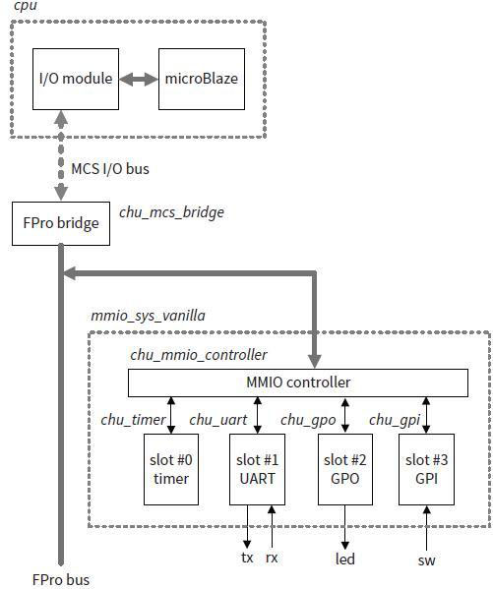
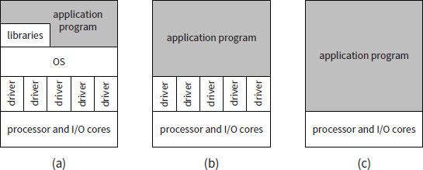
Development System

Slide 2
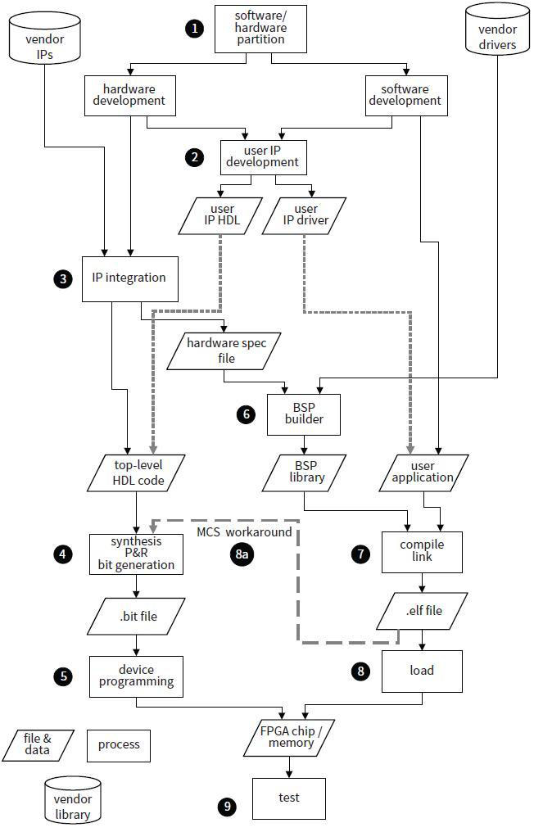
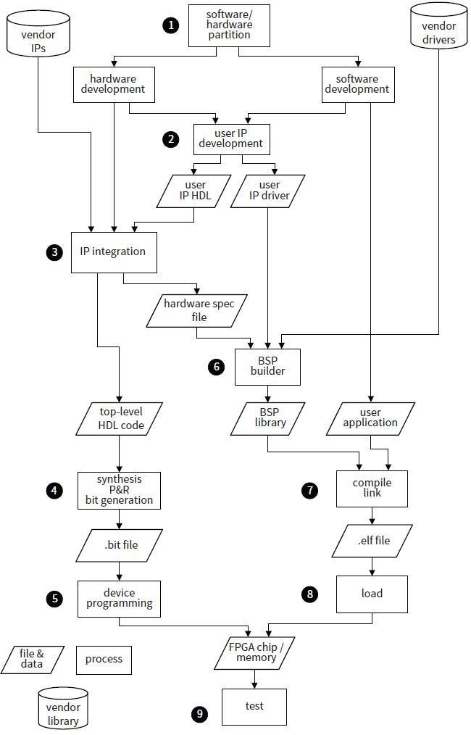
Development flow
Step 1:
Step 2:

Slide 3
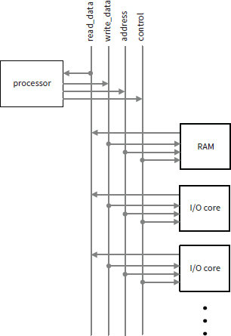
FPro Bus
fp_wr_data
fp_rd
fp_mmio_cs
fp_rd_data
fp_addr
fp_wr
fp_rd_data (slave to master; 32-bit)
fp_wr_data (master to slave; 32-bit)
fp_addr (master to slave; 21-bit)
fp_rd (master to slave; 1-bit)
fp_wr (master to slave; 1-bit)
fp_mmio_cs (master to slave; 1-bit)

Slide 4
FPro Bridge
MCS I/O
IO_addr_strobe (master to slave 1-bit-not use)
IO_address (master to slave; 32-bit)
IO_byte_enable (master to slave 4-bit-not use)
IO_read_data (slave to master; 32-bit)
IO_read_strobe (master to slave; 1-bit)
IO_ready (slave to master; 1-bit-always asert)
IO_write_data (master to slave; 32-bit)
IO_write_strobe (master to slave; 1-bit)
FPro Bus
fp_rd_data (slave to master; 32-bit)
fp_wr_data (master to slave; 32-bit)
fp_addr (master to slave; 21-bit)
fp_rd (master to slave; 1-bit)
fp_wr (master to slave; 1-bit)
fp_mmio_cs (master to slave; 1-bit)
0xc000_147c
enable
bridge
(8-bit)
I/O register
Address
(21 bit)
1100_0000_0000_0000_0001_0100_0111_1100
select
mmio
(1-bit)
slot = 40
reg = 31
word
addressable
(2-bit)

Slide 5
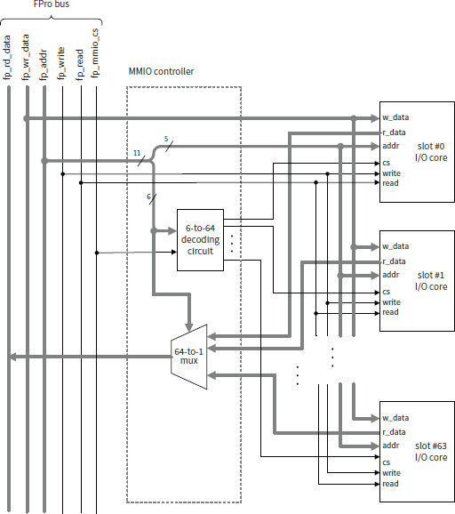
MMIO slot interface
addr (bus to core 5-bit)
rd_data (core to bus 32-bit)
wr_data (bus to core 32-bit)
write (bus to core 1-bit)
read (bus to core 1-bit)
cs (bus to core 1-bit)

Slide 6
Timer core development

